Slide 1
Open Radar Science. Leading from Behind
Scott Collis
Robert Jackson, Zach Sherman, Jason HemEdinger and Mark Picel
And so many more….
Atmospheric Scientist, Argonne National Laboratory.
Senior Institute Fellow, Northwestern University.
Argonne National Laboratory

Slide 2
What is in this talk: Key take homes
A Talk About Weather Radar.
Welcome to the world of open radar science.
This PPT is a bit backup, and a bit background..
I will show some examples of open source software that is designed to work with weather radar.
It I is built around several technologies including Jupyter, Binder and Pangeo…
Fingers crossed ☺

Slide 3
What is in this talk: Key take homes
A Talk About Weather Radar.
Welcome to the world of open radar science.
This PPT is a bit backup, and a bit background..
I will show some examples of open source software that is designed to work with weather radar.
It I is built around several technologies including Jupyter, Binder and Pangeo…
Fingers crossed ☺
print(“Hello, world!”)

Slide 4
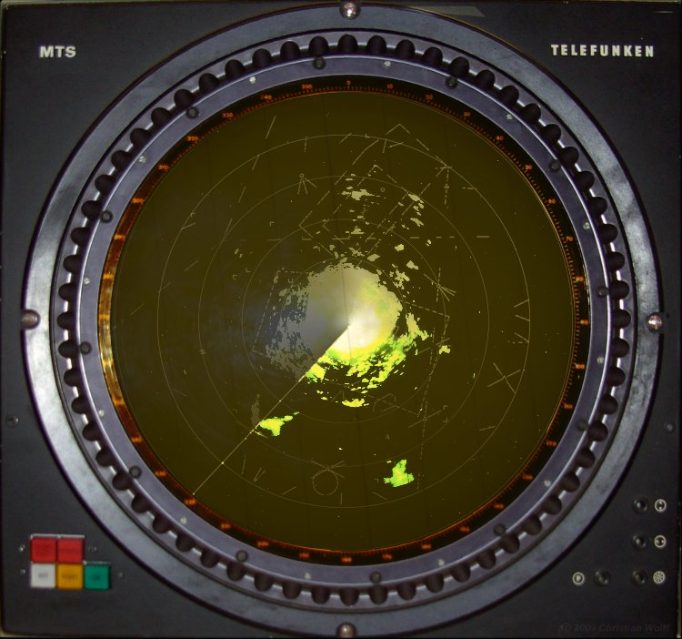
Radio Detection And Ranging
First used for the detection of aircraft in 1935
Pulses of electromagnetic radiation were emitted along a narrow beam and scattered off objects (aircraft, birds, insects, raindrops..)
Meteorological returns were considered a nuisance, making detection of enemy aircraft difficult
…Once person’s noise is another person’s signal!

Slide 5
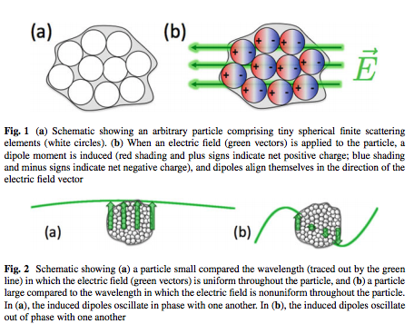
Some background
… on radar remote sensing…
How do distributed small scatters react to a time varying electric field?
Scattering is caused by dipoles becoming polarized and radiating a time-lagged EM wave.
Rayleigh theory requires the diameter of the scatterer to be much smaller than the wavelength of the radiation to ensure the time varying electromagnetic field is uniform.
Courtesy Matt Kumjian PSU

Slide 6
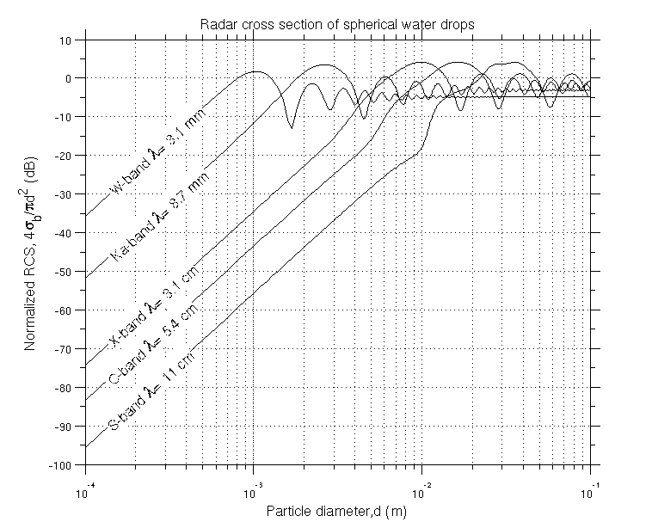
Reflectivity
Radar reflectivity is as simple as how much energy is reflected back from an object.
It is
(see Doviak and Zrnic, p35) Since wavelength and other factors are independent of N we can define reflectivity factor:
Assuming a function from (DSD) of N yields:

Slide 7
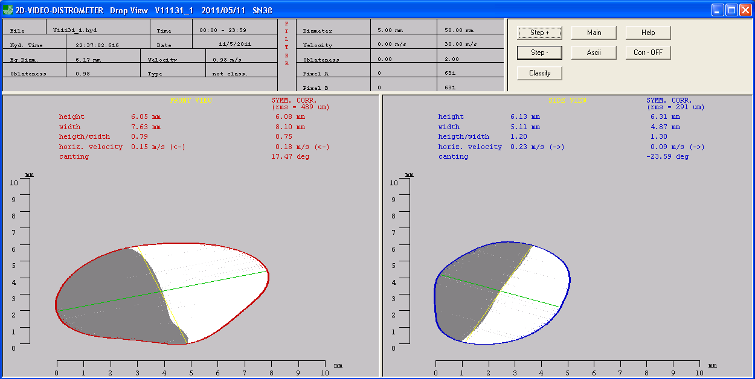
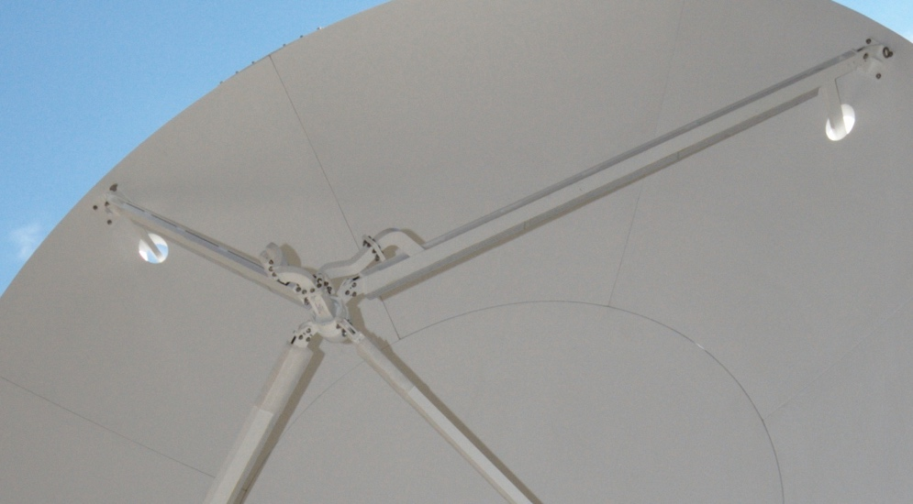
Radar Science 201
Dual Polarimetric Radar
Differential reflectivity (aka ZDR) which is the ratio between the horizontal and vertical returns, this is a measure of the oblateness of drops which are squished as they fall.. ~ D0
Differential propagation phase (aka PhiDP), this is the difference in phase between the horizontal and vertical return and the specific differential phase (aka KDP) which is the radial differential of PhiDP. The relation between Kdp and the DSD is complex however can be approximated to the 4.24th moment in heavy rain and the 5.6th moment in light precipitation (Zrnić and Ryzhkov 1996).
Correlation coefficent (RhoHV), correlation between pols..

Slide 8
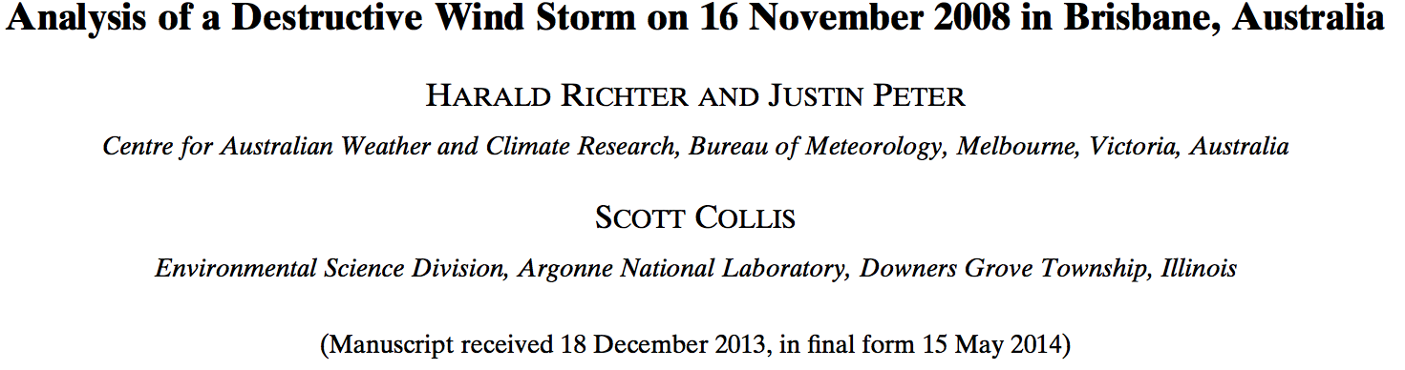
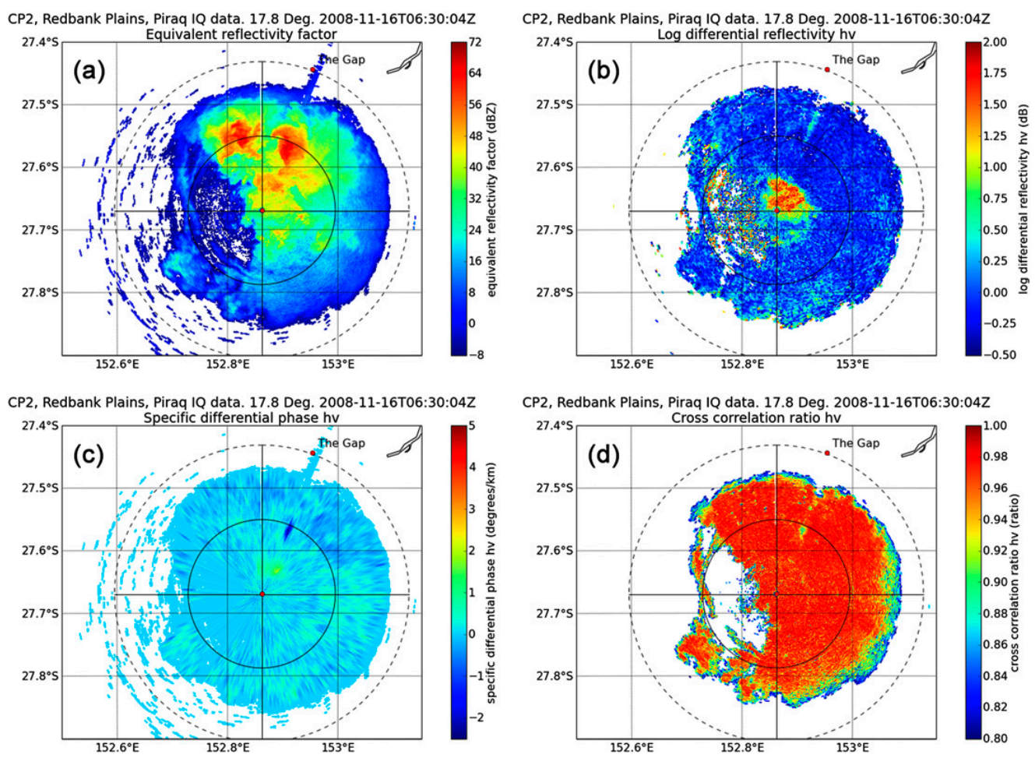

Slide 9
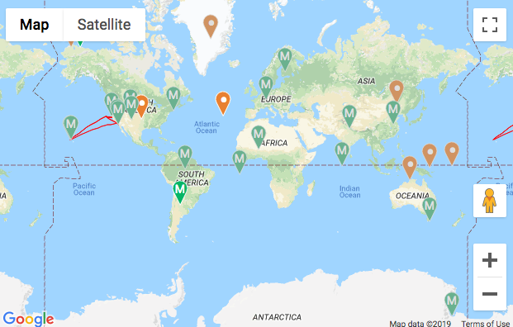
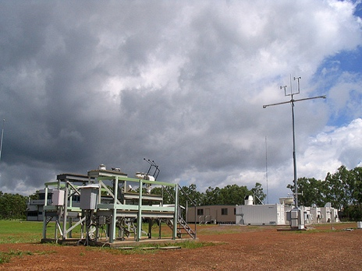
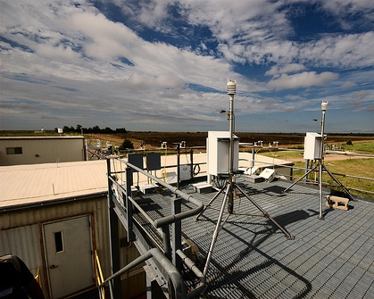
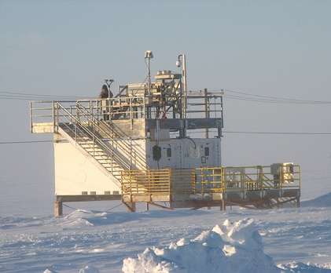
The Atmospheric Radiation Measurement Program
A DoE Office of Science User Facility
The Atmospheric Radiation Measurement Climate Facility is a DoE user facility with the goal to improve climate models.
A key area for improvement is the representation of clouds in climate and cloud resolving models.
The Facility operates fixed sites in Oklahoma, Alaska, Papua New Guinea and Darwin, Australia.
As well as producing raw observations the facility invests research in producing Value Added Products.

Slide 10
Open source radar
With so many radars and different formats we needed to get our act together.
Just before joining the lab in 2010 I had made the switch from IDL to Python. Python provided a wonderful menagerie of data objects to use!
In 2012 I went to DoE with a proposal to build a framework with a translation layer and make it open source … I had just discovered GitHub and wanted in on that!
Thus the Python-ARM Radar Toolkit was born.

Slide 11
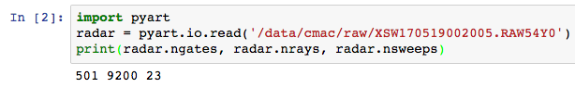
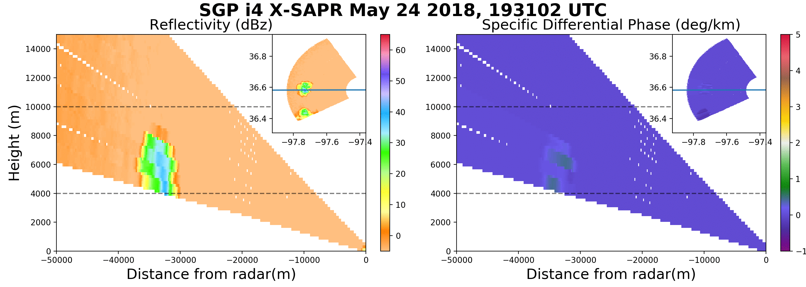
The Python ARM Radar Toolkit
Philosophy: It’s all about the data model.
Py-ART’s central core is a data model for gated data with pointing information.
Py-ART created a way of representing radar data in the Python programming language that mirrors the CF-Radial standard.
Py-ART has a cloud functions to correct, retrieve and grid radar data.
By keeping a limited scope Py-ART aims to “do less better”.
There is now a rich ecosystem of packages that interact: ART-View, CSU tools, PyTDA, Multidop to name a few. Oh and we are working on TINT!
Animation courtesy of users Marcus van Lier-Walqui
and Sara E. Lytle
Data: Andrei Lindenmaeir – ARM Mentor

Slide 12

























Slide 13
Break out to course
https://github.com/ANL-DIGR/saws-demo

Slide 14
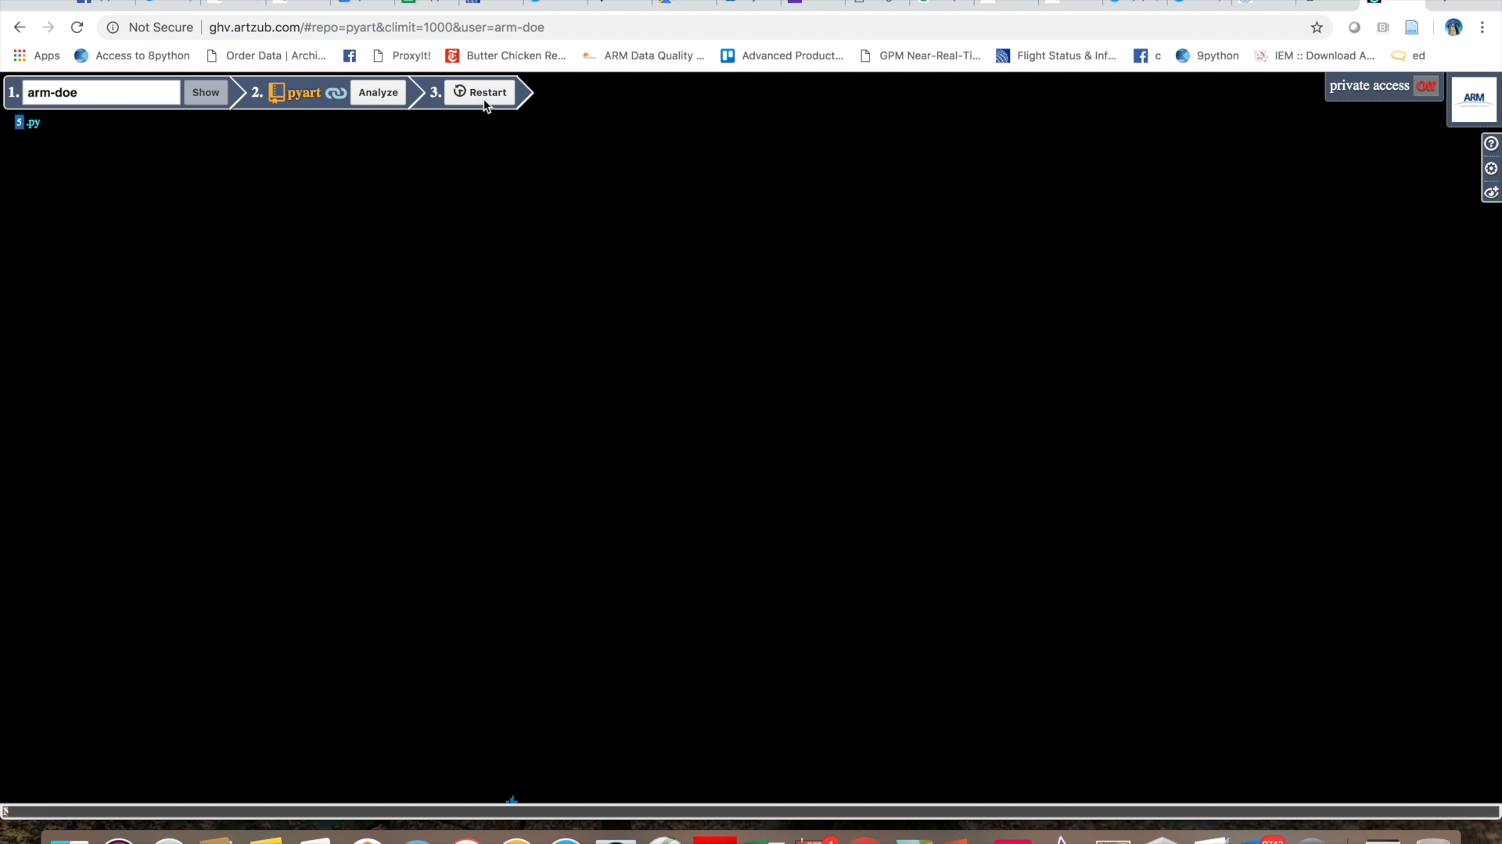
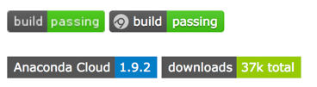
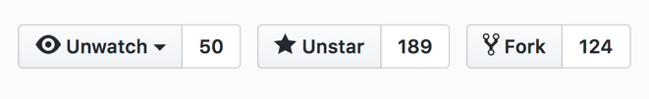
The power of community software.. But, you need standards, unit testing and
continuous integration.
Only scollis, jjhelmus, zssherman, rcjackson and rumpkie
have received ARM funds. The other 28 have not…

Slide 15
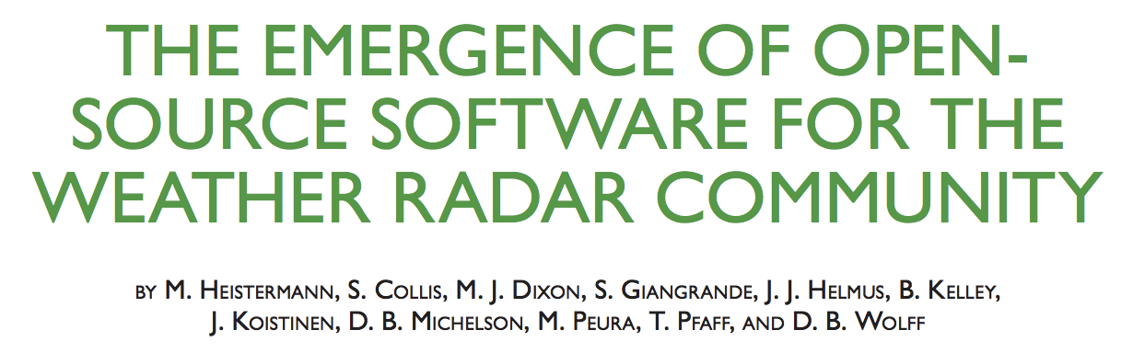
Open Radar Partnership
We are all in this together…
Python efforts in Radar Meteorology nucleated in parallel in Europe and the USA.
In addition the long standing TITAN software cloud received NSF support for a modernization surge.
A short course at ERAD 2014 led to a co-written paper which lead to a rotating course between ERAD and the AMS radar conference.
We now have a web presence and a growing ecosystem of identified packages.

